Slide 1
COMMUNITY
ENGAGED RESEARCH
TRAINING
Day 2 - May 7, 2021
Notes:
Welcome slide / display on shared screen as participants enter space

Slide 2
How we’ll spend our time today
1
3
University-Community Scenario Discussions
Air, Water, Blood: The Power of Community-Engaged Research
Kettleman City project documentary film and panel discussion
2
Small group university-community conversations
Notes:
(Shosha)

Slide 3
1. University-Community Scenarios Exercise
Notes:
(Jonathan)

Slide 4
Scenario 1: Ownership and communication
of research results
A community-based organization (CBO) approached a researcher to initiate a research project because they were concerned with a contaminant in their community.
Data was collected with the support of the CBO. Towards the end of the project, the CBO asked to review the research findings (analyzed data) before the researcher presented them publicly or shared them with the state agency regulating the environmental contaminant being studied.
The CBO has an adversarial relationship with the state agency and is involved in several lawsuits with them. The researcher is concerned that their objectivity will be questioned if they allow the community organization to view the data before it is published or to influence how the results are communicated.
Notes:
(Jonathan)

Slide 5
Notes:
(Jonathan)

Slide 6
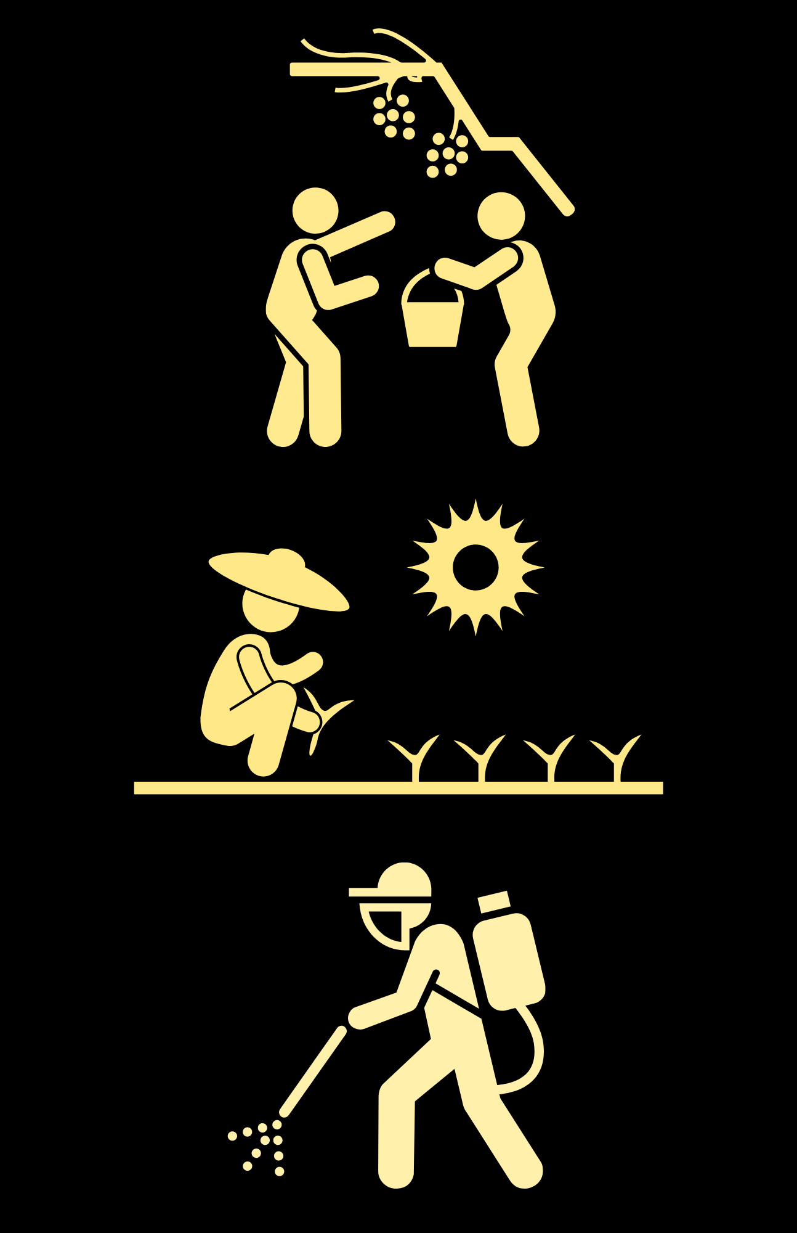
Scenario 2: Accessibility and Language
A community partner and researcher are collecting data via interviews with a local farmworker community.
There are some people who speak Spanish on the research team, but they discover that many farmworkers speak indigenous languages that no one on the team is familiar with and are not fluent in Spanish.
The team didn’t budget for translation/interpretation in any indigenous languages, so they decide to conduct interviews only with farmworkers who speak Spanish.
After the project is complete, the team holds a series of community meetings to share the results. Fact sheets are provided in English and Spanish and one of the researchers serves as a Spanish/English interpreter.
The meetings are poorly attended, and after one meeting, a participant shares that a question critical of the study was inaccurately interpreted from Spanish to English. The meetings also do not include any Indigenous community members.
Notes:
(Shosha)

Slide 7
Notes:
(Shosha)
This scenario is about how accessibility -- particularly language accessibility, but not limited to language accessibility -- can impact a study at various stages of the work. The first question is about the impact of language accessibility on sampling and participation in the study. (READ)
The second question is about dissemination of results and meeting accessibility. (READ)
The third question touches on how research teams handle unanticipated costs, particularly costs related to accessibility. (READ)
Last, wanted to touch on how language accessibility impacts all studies conducted in a linguistically diverse state like CA, regardless of whether the participants themselves are a LEP population (READ).

Slide 8
Scenario 3: Compensation, shared benefits,
and trust
A researcher and community-based organization (CBO) are writing a grant proposal together for a large, multi-year project that has the potential to impact policy.
The researcher sent a budget to the community partner that includes $5000/year for the community partner, noting that this is the maximum amount that can be paid to the partner without sacrificing the quality of the scientific research.
The CBO responded that 5k is significantly lower than the budget they require to participate in the project. The proposal is due in a few days and the researcher is unsure how to respond.
.
Notes:
(Jonathan)

Slide 9
Notes:
(Jonathan)

Slide 10
2. Small group university-community conversations
Notes:
(Sarina)

Slide 11
Notes:
(Sarina)

Slide 12
Notes:
(Sarina)
In-room facilitation notes:
Existing teams -- ask these question about your actual project / partners.
Teams without a community partner identify (Only applies to Shosha’s breakout room)-- more of a role-playing / workshopping exercise.
All -- please introduce yourself the first time you speak.
RESEARCHERS -- identify your “issue area” in lay terms when asking community partners a question. I.E. “What community organizing or policy advocacy is currently happening in your community around water quality?” “How could your organization use research findings about wildfire smoke toxicity to support your work?”
COMMUNITY REPRESENTATIVES -- can ask questions as is.
To get started -- RESEARCHERS -- How do you imagine the results of your research being useful for community members? And then community representatives can respond with their perspective.. If researchers aren’t sure, briefly describe the potential results and then the community representatives in the group can give their perspective.

Slide 13
3. Air, Water, Blood: The Power of Community Engaged Research
A documentary screening
Notes:
(Jennifer)

Slide 14
3. Air, Water, Blood: The Power of Community Engaged Research
A documentary by Paige Bierma, followed by a conversation with Clare Cannon, Miguel Alatorre, and Maricela Mares-Alatorre.
#DocumentingKettleman
Notes:
(Jennifer)

Slide 15
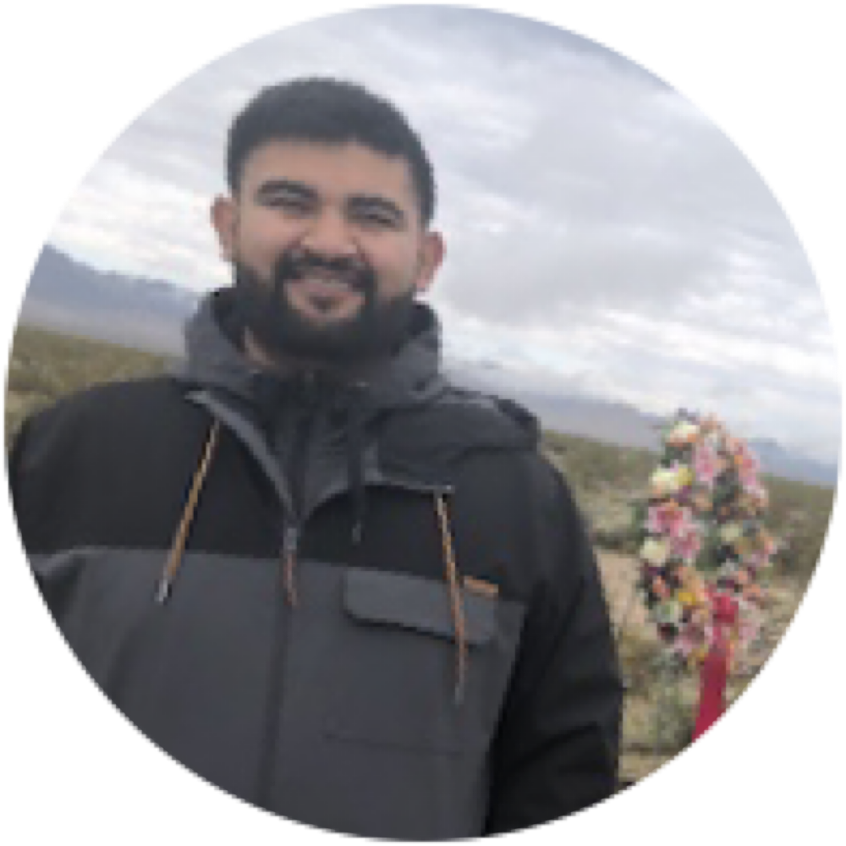
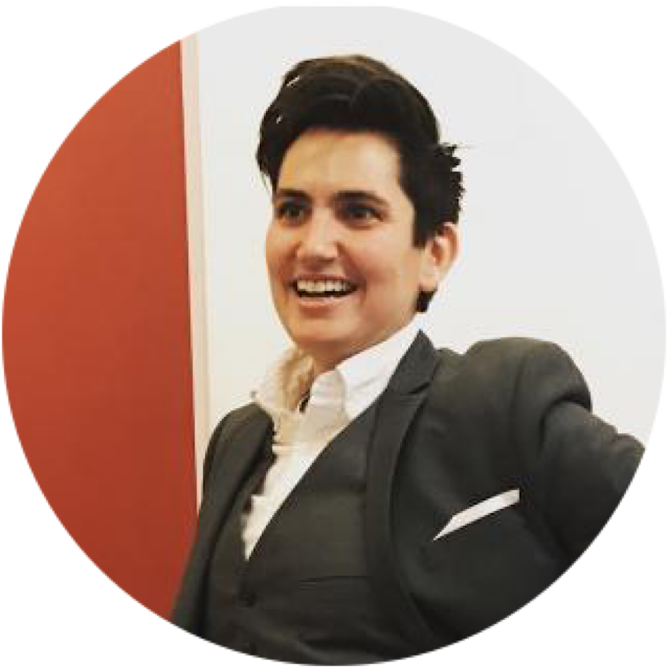
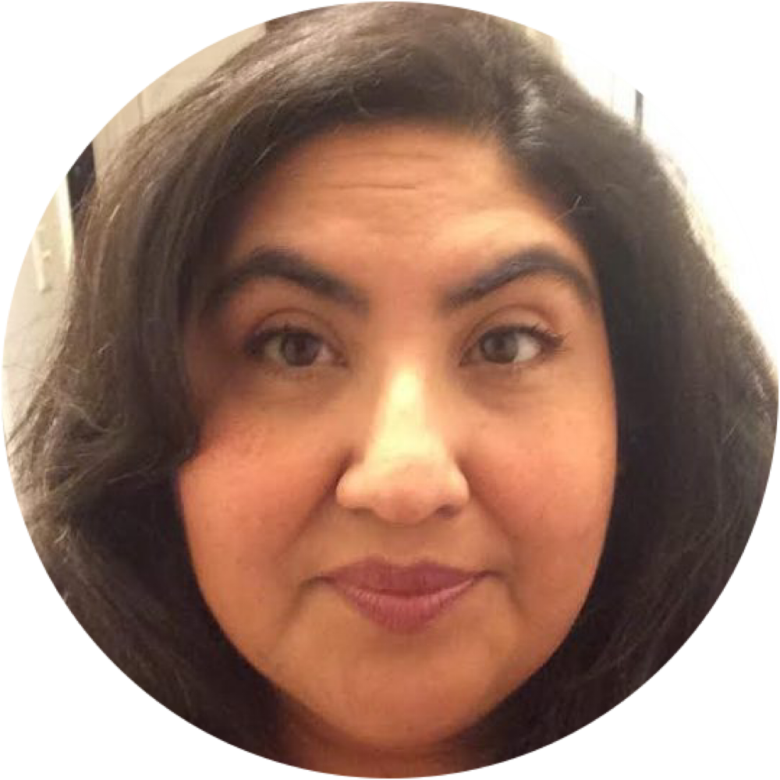
Kettleman City Research Team
Clare
Cannon
Maricela Mares-Alatorre
Assistant Professor
UC Davis Department of Human Ecology
Community Organizer & Policy Advocate
Miguel
Alatorre
Community Organizer & Policy Advocate
Notes:
(Jennifer)

Slide 16
5. Next steps
Please fill in training evaluation (sent by email)
CEC will reach out to set up quarterly check-ins for individualized, project-specific support
Supplemental support materials will be provided
Notes:
(Shosha)
Next steps:
We will send you an eval right after training
We will follow up next week with supplemental materials that go more in depth with all the material we shared in both parts of the training
Please gather questions, individual project considerations for our first check in meeting with your team -- typical “Early-stage support” could include:
Discuss identifying a partner if you haven’t
Beginning IRB
Other unanswered questions + individual considerations
Partnership agreements

